Slide 1

CubeSat
Design space exploration and optimization David Malawey Hung Nguyen
For Course Final Presentation
► Texas A&M Engineering – ME689
► Multidisciplinary Systems Design and Optimization
► Professor: Dr. Douglas Allaire
► Semester: Spring 2015, College Station Campus
(team project for preliminary work, with DM & HN followed by individual work DM for utilization in masters thesis)

Slide 2
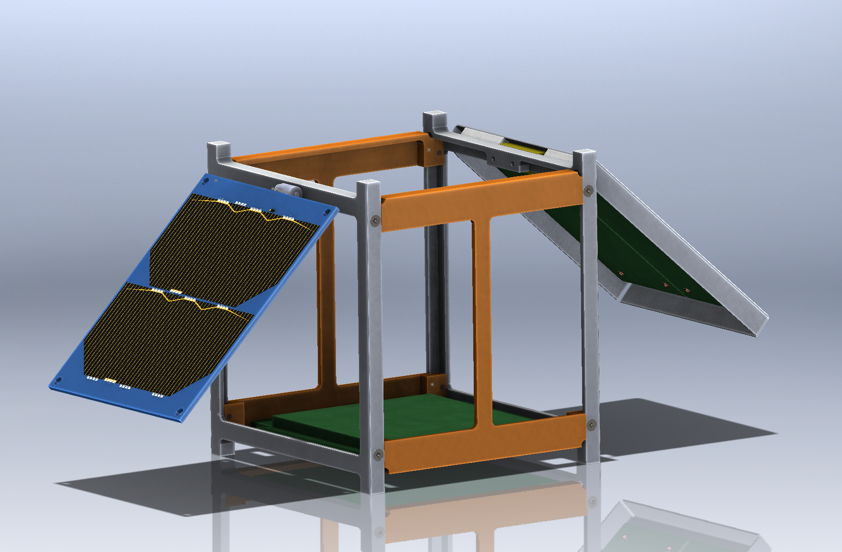
Contents:
Problem Formulation
Motivation and Challenges
Objectives and Constraints
Model and Simulation
Model Overview and Description
Benchmarking and Validation
Optimization
Algorithms and tuning
Post Optimality Analysis
Multi-Objective and Tradeoff Analysis
Conclusions and Recommendations

Slide 3
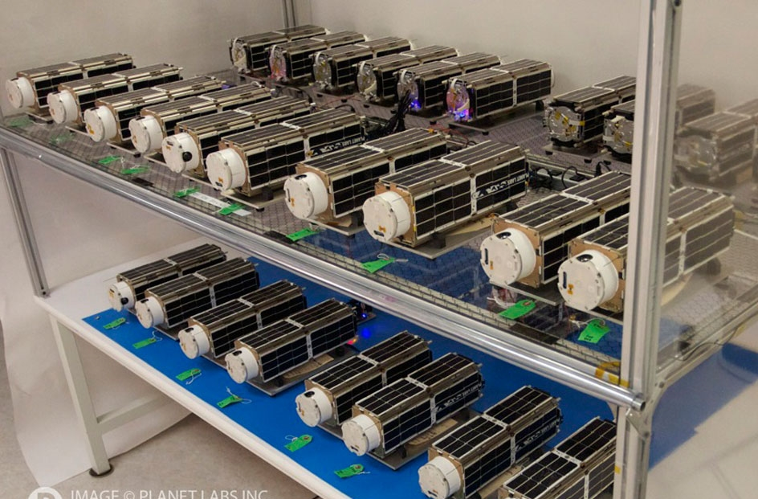
Problem Formulation
Motivation
Over 200 cubesats flown, industry growing.
Typical Missions:
measure radiation
take photos of earth
microgravity experiments
Test a small scale system before implementing a multi-million $ satellite
Design a framework that can be reoptimized for different missions
Determine the best configuration as the actual project moves forward
Capstone team is developing a “motherboard.”
Estimates will be converted to hard parameters over time and testing.
Take advantage of heuristic data from previous designs
Challenges
Lack of heuristic data (for example, velocity vector disturbance)
Lack of expertise in each module (ie thruster design)
Budgeting the physical volume
Background Photo: Planet labs Doves aim to create a constellation that images earth every 24 hours.

Slide 4
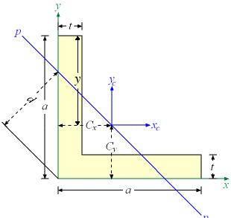
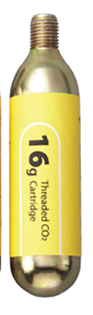
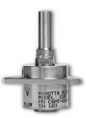
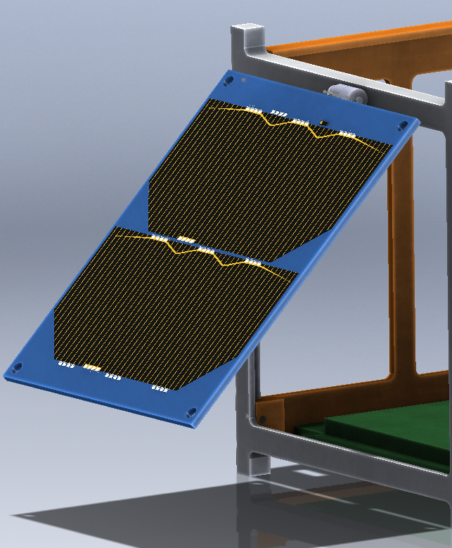
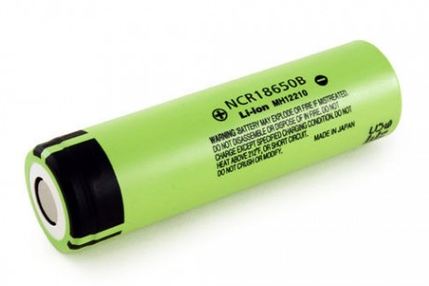
Problem Formulation
Objectives | Parameters | Constraints
Min Mass | Mission duration | (1) Power required
Min Cost | Solar Panel Power | (2) Structure bending stiffness
 | Battery Capacity | (built in) propellant sufficient
 | Flight Disturbance
 | Volume of a propellant tank
Design Vector
X(1) | X(2) | X(3) | X(4) | X(5) | X(6)
Propellant | Thruster type | Structure material | Solar Panels | Batteries | Structure rail width
Hydrogen Helium Neon Nitrogen Argon Krypton Xenon Freon 14 Methane Ammonia | Moog Marotta Lee LHDB | 6061 T6 Aluminum Titanium A36 Steel | Integers 0~4 | Integers 1~unlimited | 3mm~inf
Marotta micro thruster
Notes:
David

Slide 5
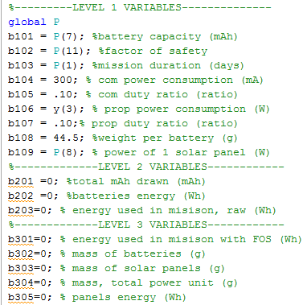
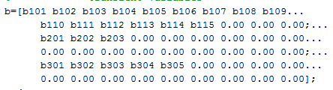
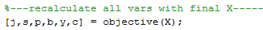
Model and Simulation
Model Overview
Each module outputs a matrix of all variables
Design vector
Structure
Propulsion
Battery/Power
Cost
Mass
Notes:
David

Slide 6
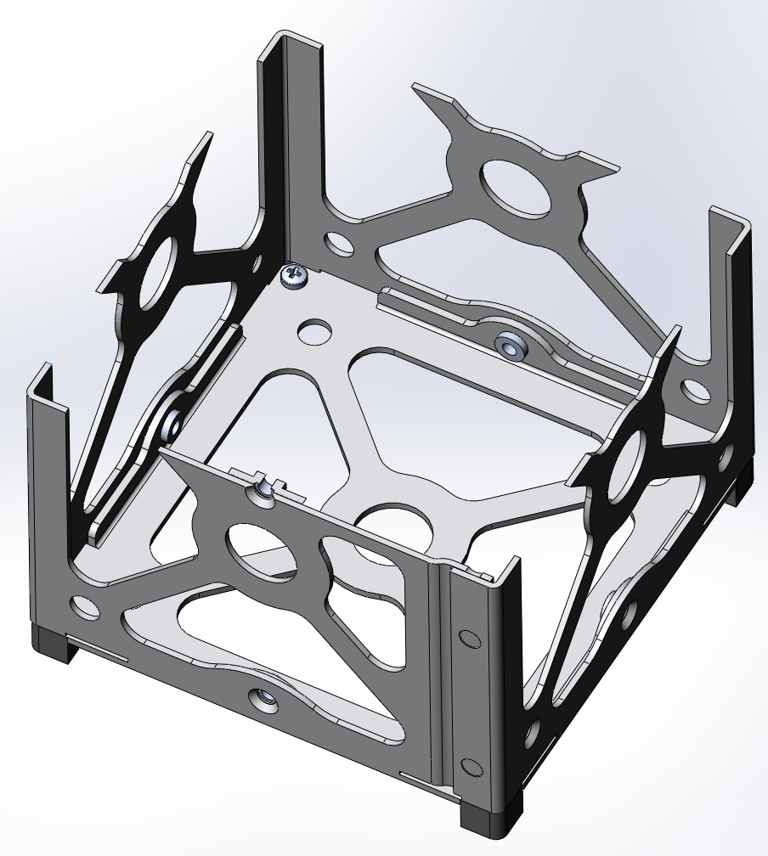
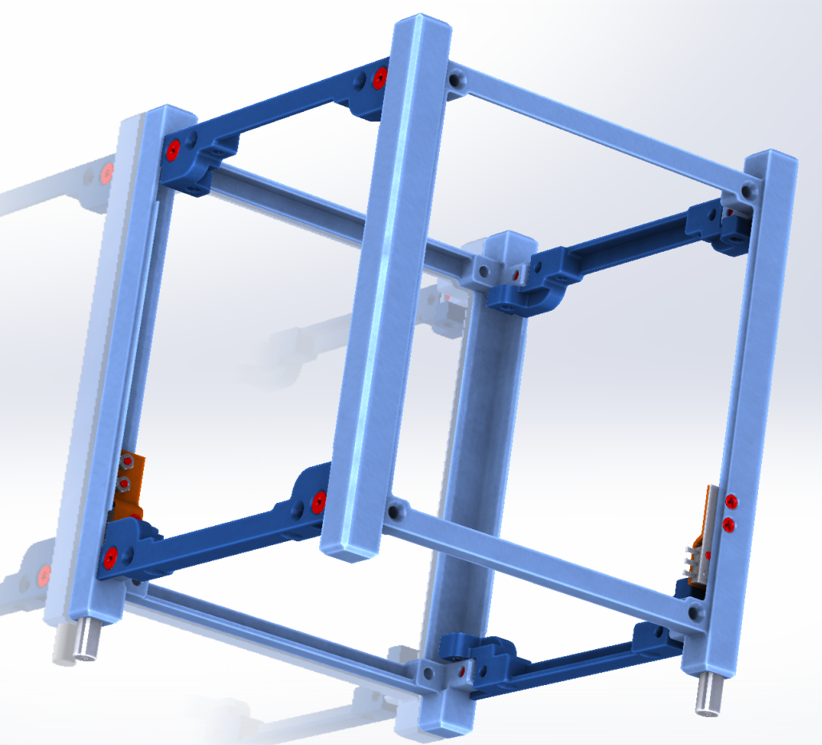
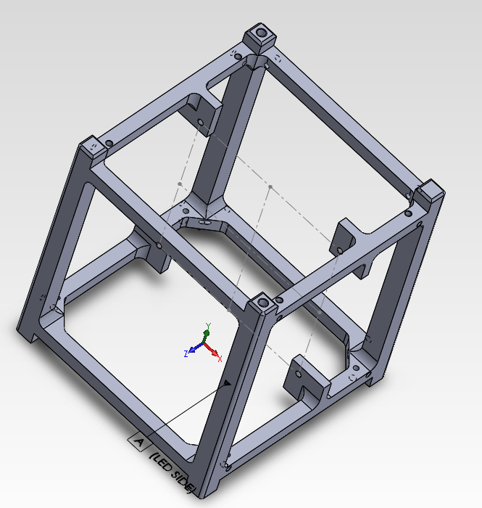
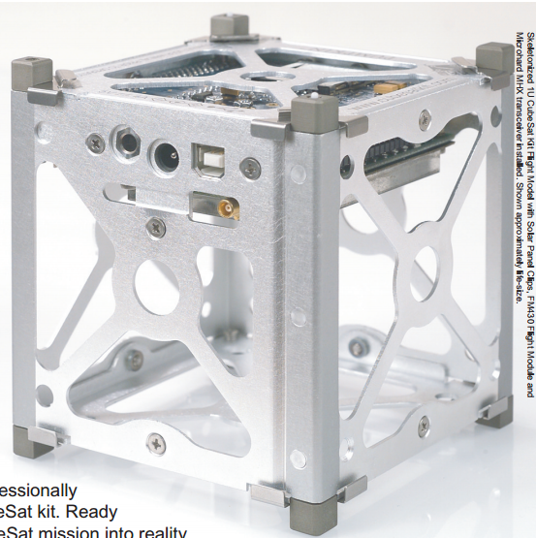
Model and Simulation
Benchmarking
Structures, materials, rigidity, manufacturability
CubeSatKit.com GomSpace.com Brown University
Cost and Mass can be benchmarked by component.
Cost
Cubesatkit.com $7500 (frame and microcontroller board)
Mass
Cubesatkit.com 300g (frame and microcontroller board)
Parameters such as solar panel wattage taken directly from suppliers.
Notes:
David

Slide 7
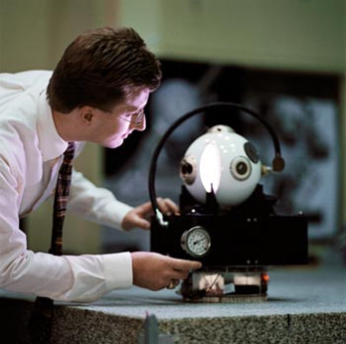
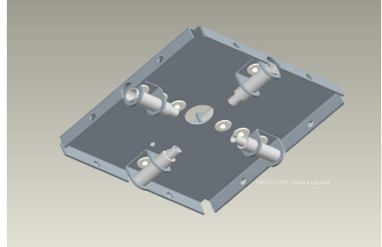
Model and Simulation
Validation
Design vector:
Xenon: used by NASA miniAERcam system
The Lee Co thruster used by Micro Aerospace Solutions, Inc.
6061 Aluminum used by most designs
Solar panels: usually maximized. (folding panels also implemented)
Breakdown variables:
NASA MiniAERcam
Micro Aerospace Solutions Thruster Module
Notes:
David

Slide 8
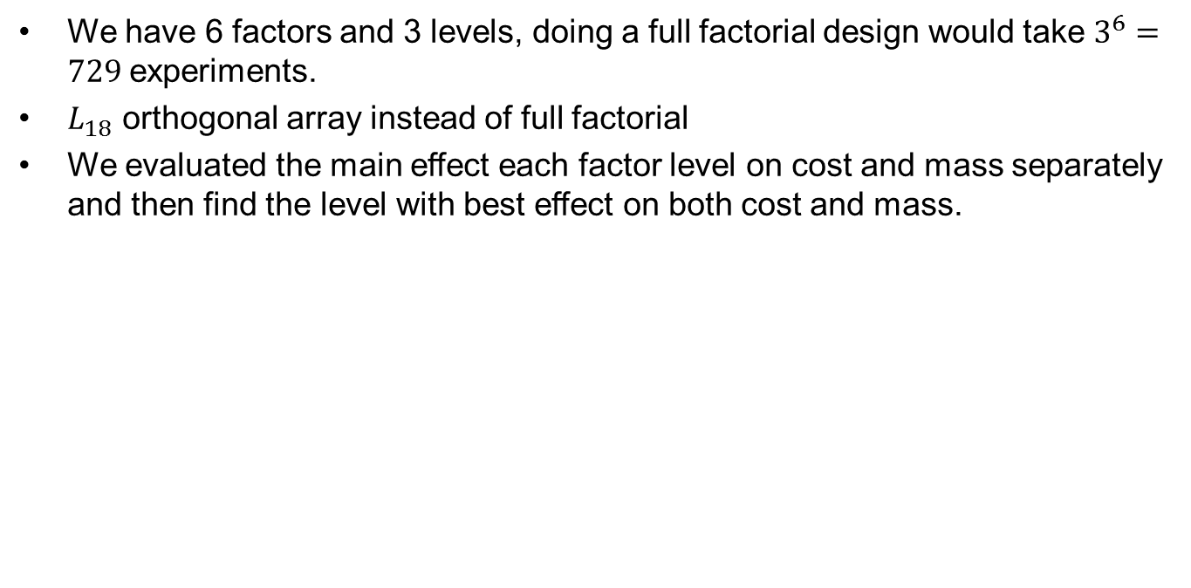
Design Space Exploration
We have 6 factors and 3 levels, doing a full factorial design would take $3^{6}=729$experiments.
$L_{18}$ orthogonal array instead of full factorial
We evaluated the main effect each factor level on cost and mass separately and then find the level with best effect on both cost and mass.
Factor | Level 1 | Level 2 | Level 3
Propellant | Hydrogen (1) | Nitrogen (4) | Xenon (7)
Thruster type | moog | marotta | lee LHDB0542115H
Structure material | Al 6061 T6 | Titanium | A36 steel
#panels | 0 | 1 | 4
#batteries | 1 | 2 | 3
Structure rail width (m) | 0.003 | 0.006 | 0.008
Notes:
Hung

Slide 9
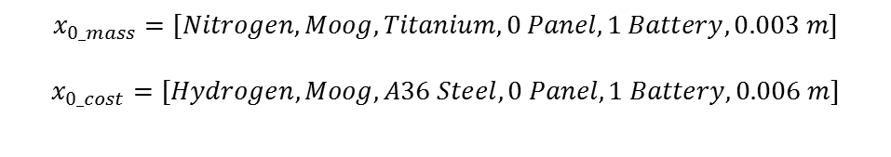
DOE Results
Variable (Factor) | Level | Cost ($E3) | ME Cost | Mass (kg) | Me Mass
Propellant | Hydrogen | $8.633 | -$0.070 | 3.586 | $1.512
 | Nitrogen | $8.654 | -$0.049 | 1.301 | -$0.773
 | Xenon | $8.822 | $0.119 | 1.335 | -$0.739
Thruster Type | moog | $8.322 | -$0.381 | 1.853 | -$0.221
 | marotta | $8.690 | -$0.013 | 2.428 | $0.355
 | lee LHDB0542115H | $9.096 | $0.393 | 1.940 | -$0.134
Structure Material | Al 6061 T6 | $8.633 | -$0.069 | 1.928 | -$0.145
 | Titanium | $8.822 | $0.119 | 1.873 | -$0.201
 | A36 steel | $8.653 | -$0.050 | 2.420 | $0.346
Number of Panel | 0 | $8.139 | -$0.564 | 1.373 | -$0.701
 | 1 | $8.723 | $0.020 | 1.811 | -$0.263
 | 4 | $9.089 | $0.386 | 2.800 | $0.726
Number of Battery | 1 | $5.888 | -$2.815 | 1.685 | -$0.388
 | 2 | $8.724 | $0.021 | 1.998 | -$0.076
 | 3 | $11.496 | $2.793 | 2.538 | $0.464
Structure Width (m) | 0.003 | $8.710 | $0.007 | 1.462 | -$0.612
 | 0.006 | $8.639 | -$0.064 | 1.879 | -$0.195
 | 0.008 | $8.784 | $0.081 | 3.081 | $1.007
$$x_{0_mass}=[Nitrogen, Moog, Titanium, 0 Panel, 1 Battery, 0.003 m]$$
$$x_{0_cost}=[Hydrogen, Moog, A36 Steel, 0 Panel, 1 Battery, 0.006 m]$$
Notes:
Hung

Slide 10
Single-objective Optimization
Heuristic GA
finds global area of interest
Propellant, Thruster, Material
SQP
Local analysis
Solar Panels, Batteries, Structure width
Coupled analysis
X(1~3) passed from GA to SQP
GA➔939g
SQP➔921g

Slide 11
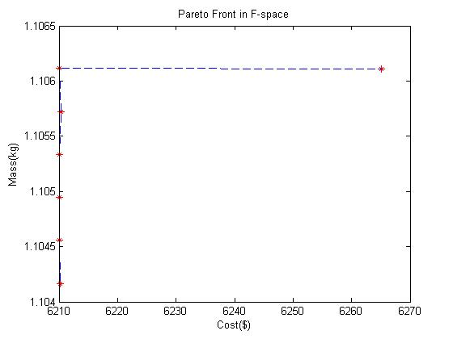
Multiple-objective Optimization
AWS Pareto Front
 | Prop | Thruster | Material | S.Panel | Battery | Rail (mm) | Cost | Mass (g)
A | Freon | Lee | Titanium | 0.690 | 1 | 3.04 | $6,333 | 802
B | Xenon | Lee | Aluminum | 0.690 | 1 | 6.354 | $6,312 | 921
C | Methane | Marotta | Steel | 0.760 | 1 | 3.00 | $5,798 | 1,293
C
NBI Toolbox Pareto Front
B
A

Slide 12
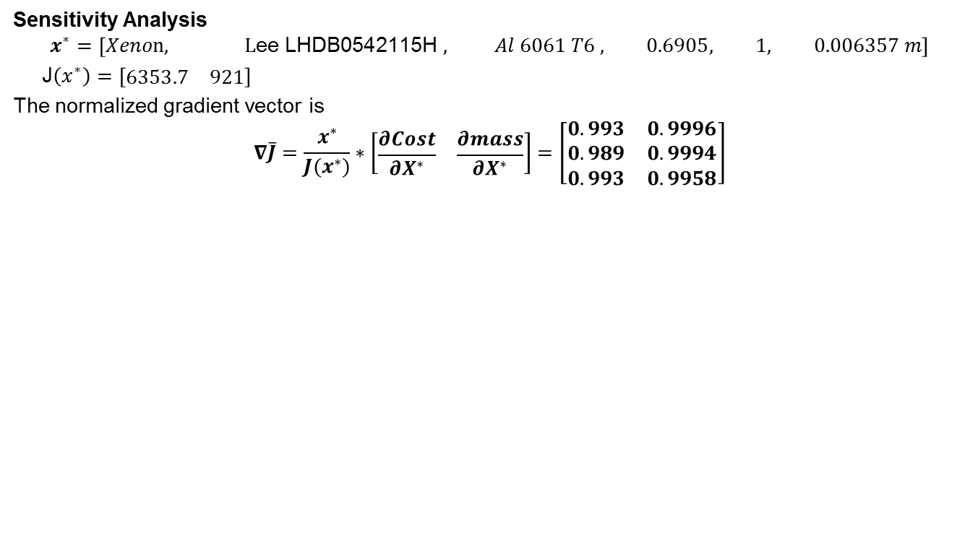
Post Optimality Analysis
Sensitivity Analysis
$$x^{∗}=\left[Xeno\text{n}\text{, }\text{L}\text{ee} \text{LHDB}\text{0542115}\text{H} , Al 6061 T6 , 0.6905, 1, 0.006357 m\right]$$
J$\left(x^{∗}\right)=\left[\begin{matrix}6353.7 & 921\end{matrix}\right]$
The normalized gradient vector is
$$∇\overline{J}=\frac{x^{∗}}{J(x^{∗})}∗\left[\begin{matrix}\frac{∂Cost}{∂X^{∗}} & \frac{∂mass}{∂X^{∗}}\end{matrix}\right]=\left[\begin{matrix}\begin{matrix}0.993 \\ 0.989 \\ 0.993\end{matrix} & \begin{matrix}0.9996 \\ 0.9994 \\ 0.9958\end{matrix}\end{matrix}\right]$$
Notes:
Hn

Slide 13
Conclusion and Recommendation
Conclusion about our methodology:
DOE is inexpensive and works great for finding initial starting point
Heuristic methods is expensive and subjective to tuning
SQP works great for local optimization but doesn’t handle discrete variables well
Recommendation:
Increase fidelity of model for future development by making better assumption
Example: thruster nozzle.
Hybrid solution: DOE -> Heuristic -> SQP
Questions…
Notes:
HN

Slide 14
Sources:
http://aercam.jsc.nasa.gov
www.cubesatkit.com
A Propulsion System Taylored to Cubesat Applications, Donald Platt, Micro Aerospace Solutions, inc.
www.planet.com

Slide 15


